Slide 1
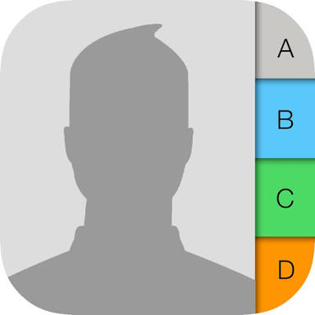
Phone book(Contacts)
By M. Fahad Abid
SAP ID #14674.

Slide 2
Phonebook is a simple application which is used to communicate with each other.
Phone book perform specific function like (searching,sorting,updating &deletion)
So best alternate is LinkedList in my opinion because it has all the operations that are related with my project

Slide 3
In detail, The functions are to add new records, listing them, modifying them and updating, search for contacts, and deleting the contact.
This project facilitie the user to record personal information such as name, phone number, email, and address while adding a record into the Phonebook. These records can then be modified, listed, searched for, and removed in the application.

Slide 4
Credits of my all creation and hard work goes to my beloved teachers
>Sir Marwat
>Sir Fawad
I just want to say that my knowledge is reflection of my honourable teachers who always support me.
THANK YOU.

